Slide 1
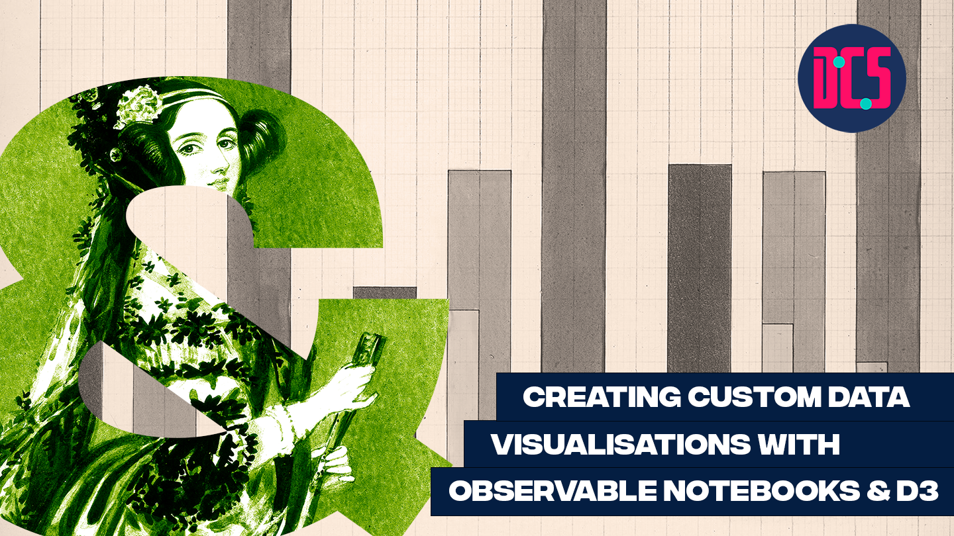
Notes:
- standard way of thinking about visualization: chart types
- Sometimes not quite enough:
- More eye catching
- Need to encode lots of data
- Will require training
- Show examples of custom visualizations (Stefanie posavec, Giorgia lupi, Federica fragapane, nadieh Bremer, Shirley wu, ...? + find examples of analytics focused applications with custom viz) warming stripes
- Introduce visual variables as alternative way of thinking about visualizations
- explain visual variables for a bar chart / line chart etc., then for more complex (custom) visualizations
DATA: Plastic Waste (Chris)
DATA: Own or Own Word in Data
https://ourworldindata.org/

Slide 2





Welcome back!
Chris Oldnall
Sarah Schöttler
www.cdcs.ed.ac.uk
Notes:
Participants to do a round of introductions

Slide 3
Schedule for Session 2
Find these slides online:
github.com/DCS-training/ custom-dataviz-observable
13:00 Welcome back & Introduction
13:15 Open session to work on visualizations
13:45 Catch up
13:55 Break
14:05 Open session to work on visualizations
15:00 Wrap up & Closing

Slide 4
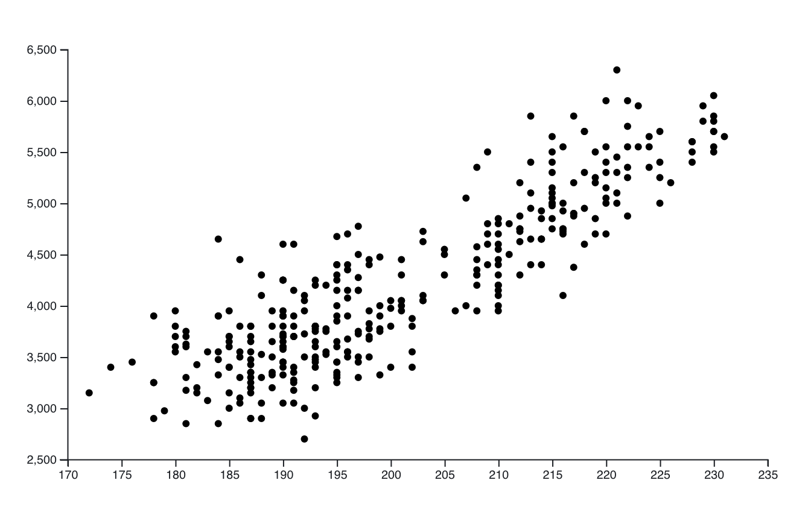
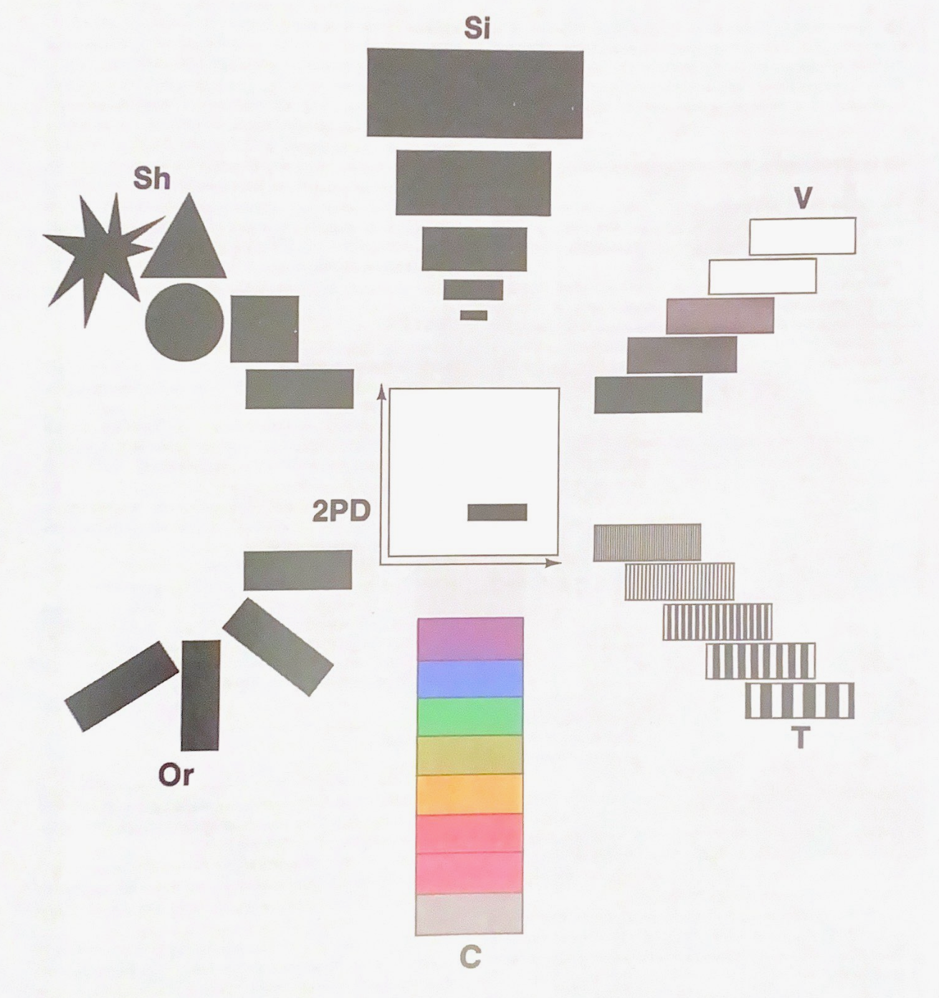
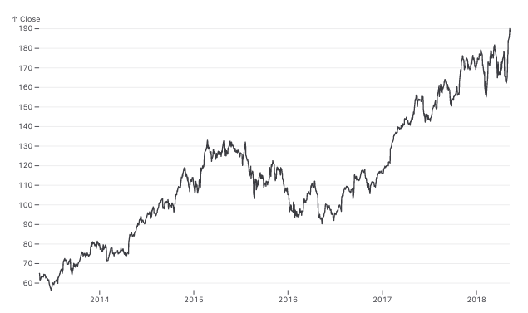
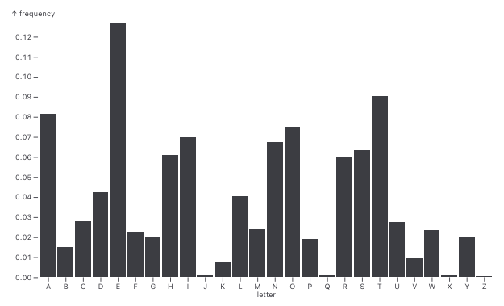
Recap: Different ways of thinking about visualization
Visualization Types
Visual Variables
Size
scatterplot
Shape
line chart
Color Value
x/y position
Texture
bar chart
Orientation
Color Hue

Slide 5
Reasons for using custom visualizations
Reasons against using custom visualizations
can be time-consuming and challenging to implement
can require more effort from users to understand
unusual
data format
more
aesthetic
complex
multi-variate patterns
highly specific
analysis goals
more
eye-catching

Slide 6

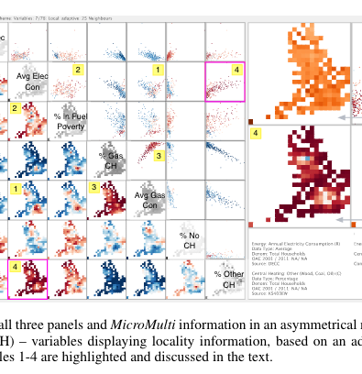
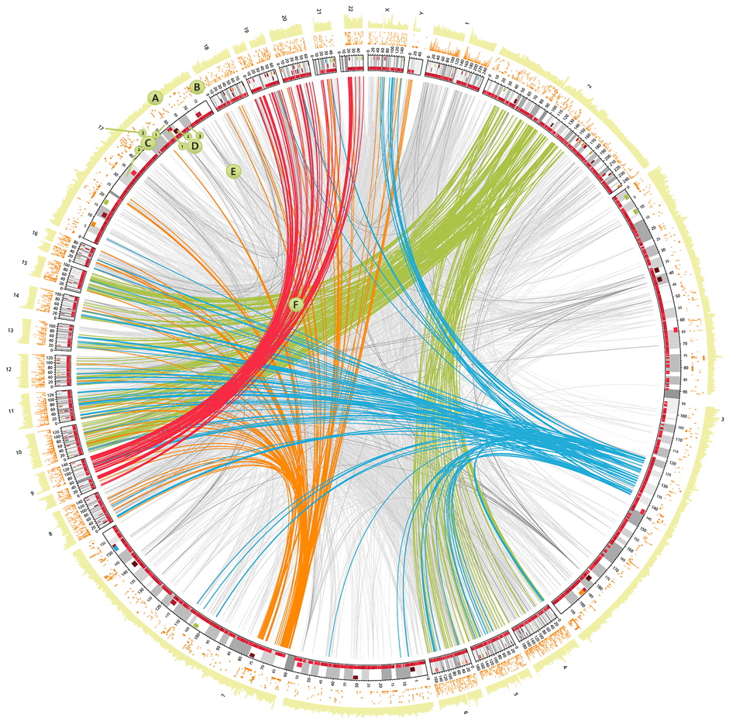
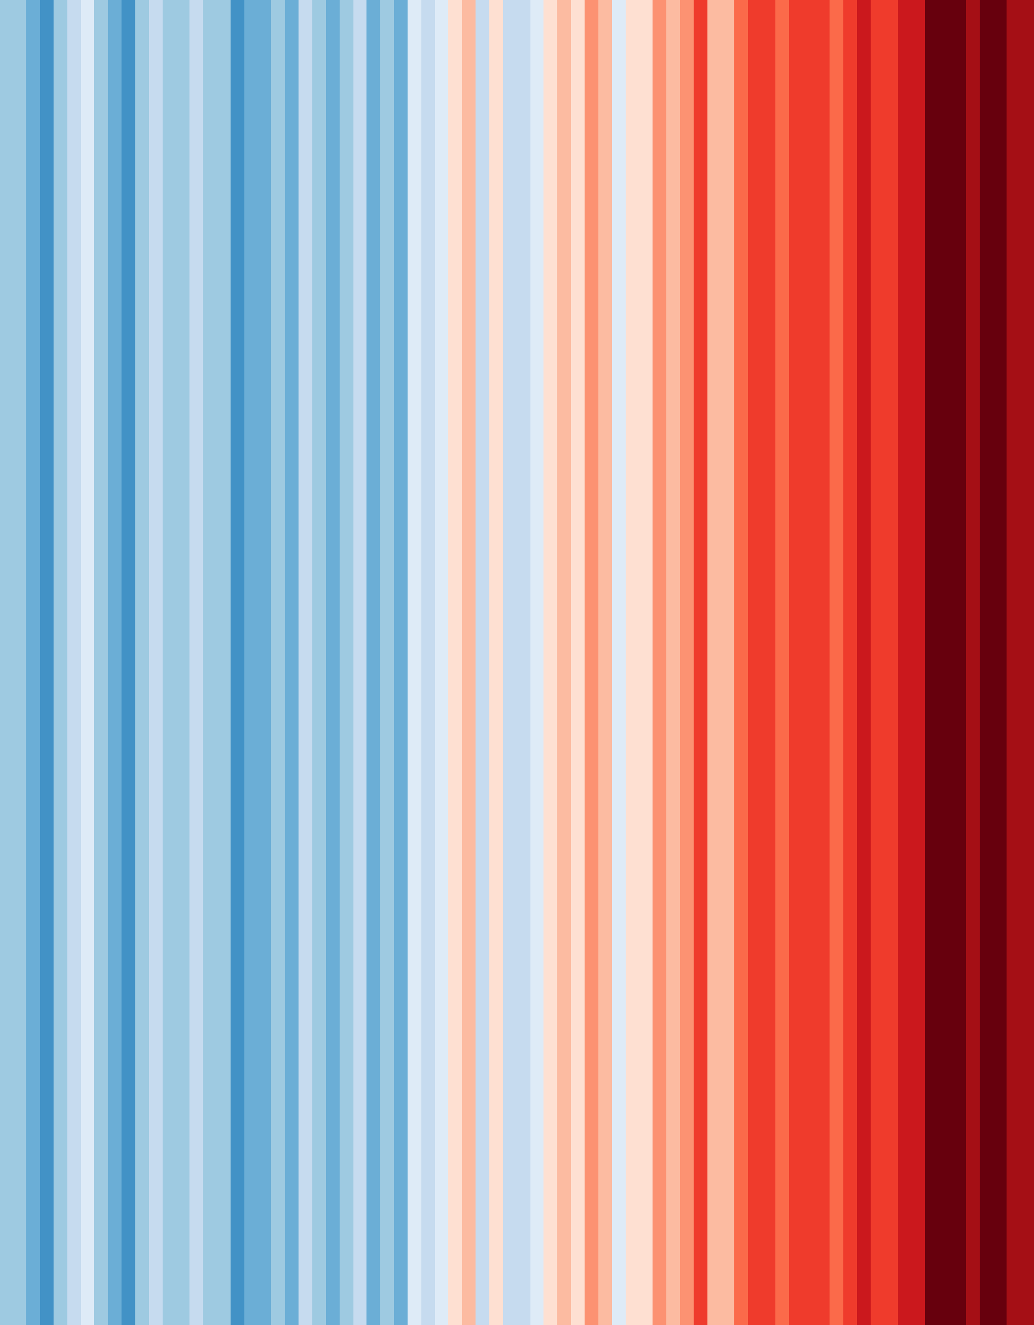
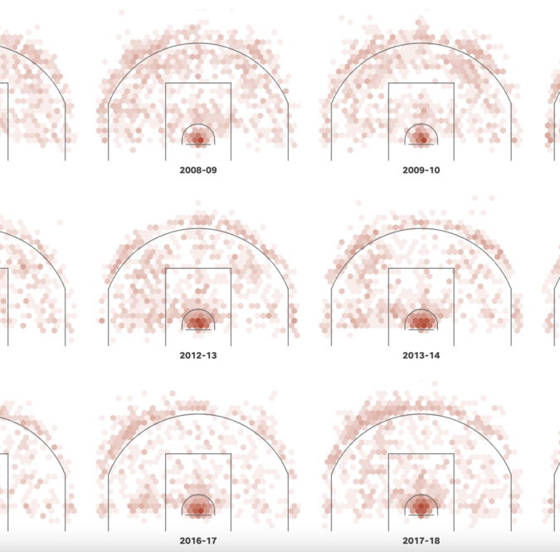
Custom Visualization Examples
(see week 1 slides for sources)

Slide 7
Coding Open Session
Continue working on the example from last week, or work with your own data
Try finding an example on Observable and “forking” it, then edit to suit your own data and visualization design
Catch up at 13:45
Break 13:55-14:05

Slide 8
Additional D3 Resources
Observable has a series of notebooks for learning D3: https://observablehq.com/@d3/learn-d3
Interactive Data Visualization for the Web (book): https://scottmurray.org/work/d3-book-2e
from 2017 so a little outdated now, but a great resource for the basics
Tutorial for creating simple charts and maps: https://www.freecodecamp.org/news/d3js-tutorial-data-visualization-for-beginners/
D3 has great documentation for looking up specific functions: https://d3js.org/api

Slide 9
Thank you!
Feedback form: see follow-up email
Link to these slides: github.com/DCS-training/ custom-dataviz-observable

